Slide 1
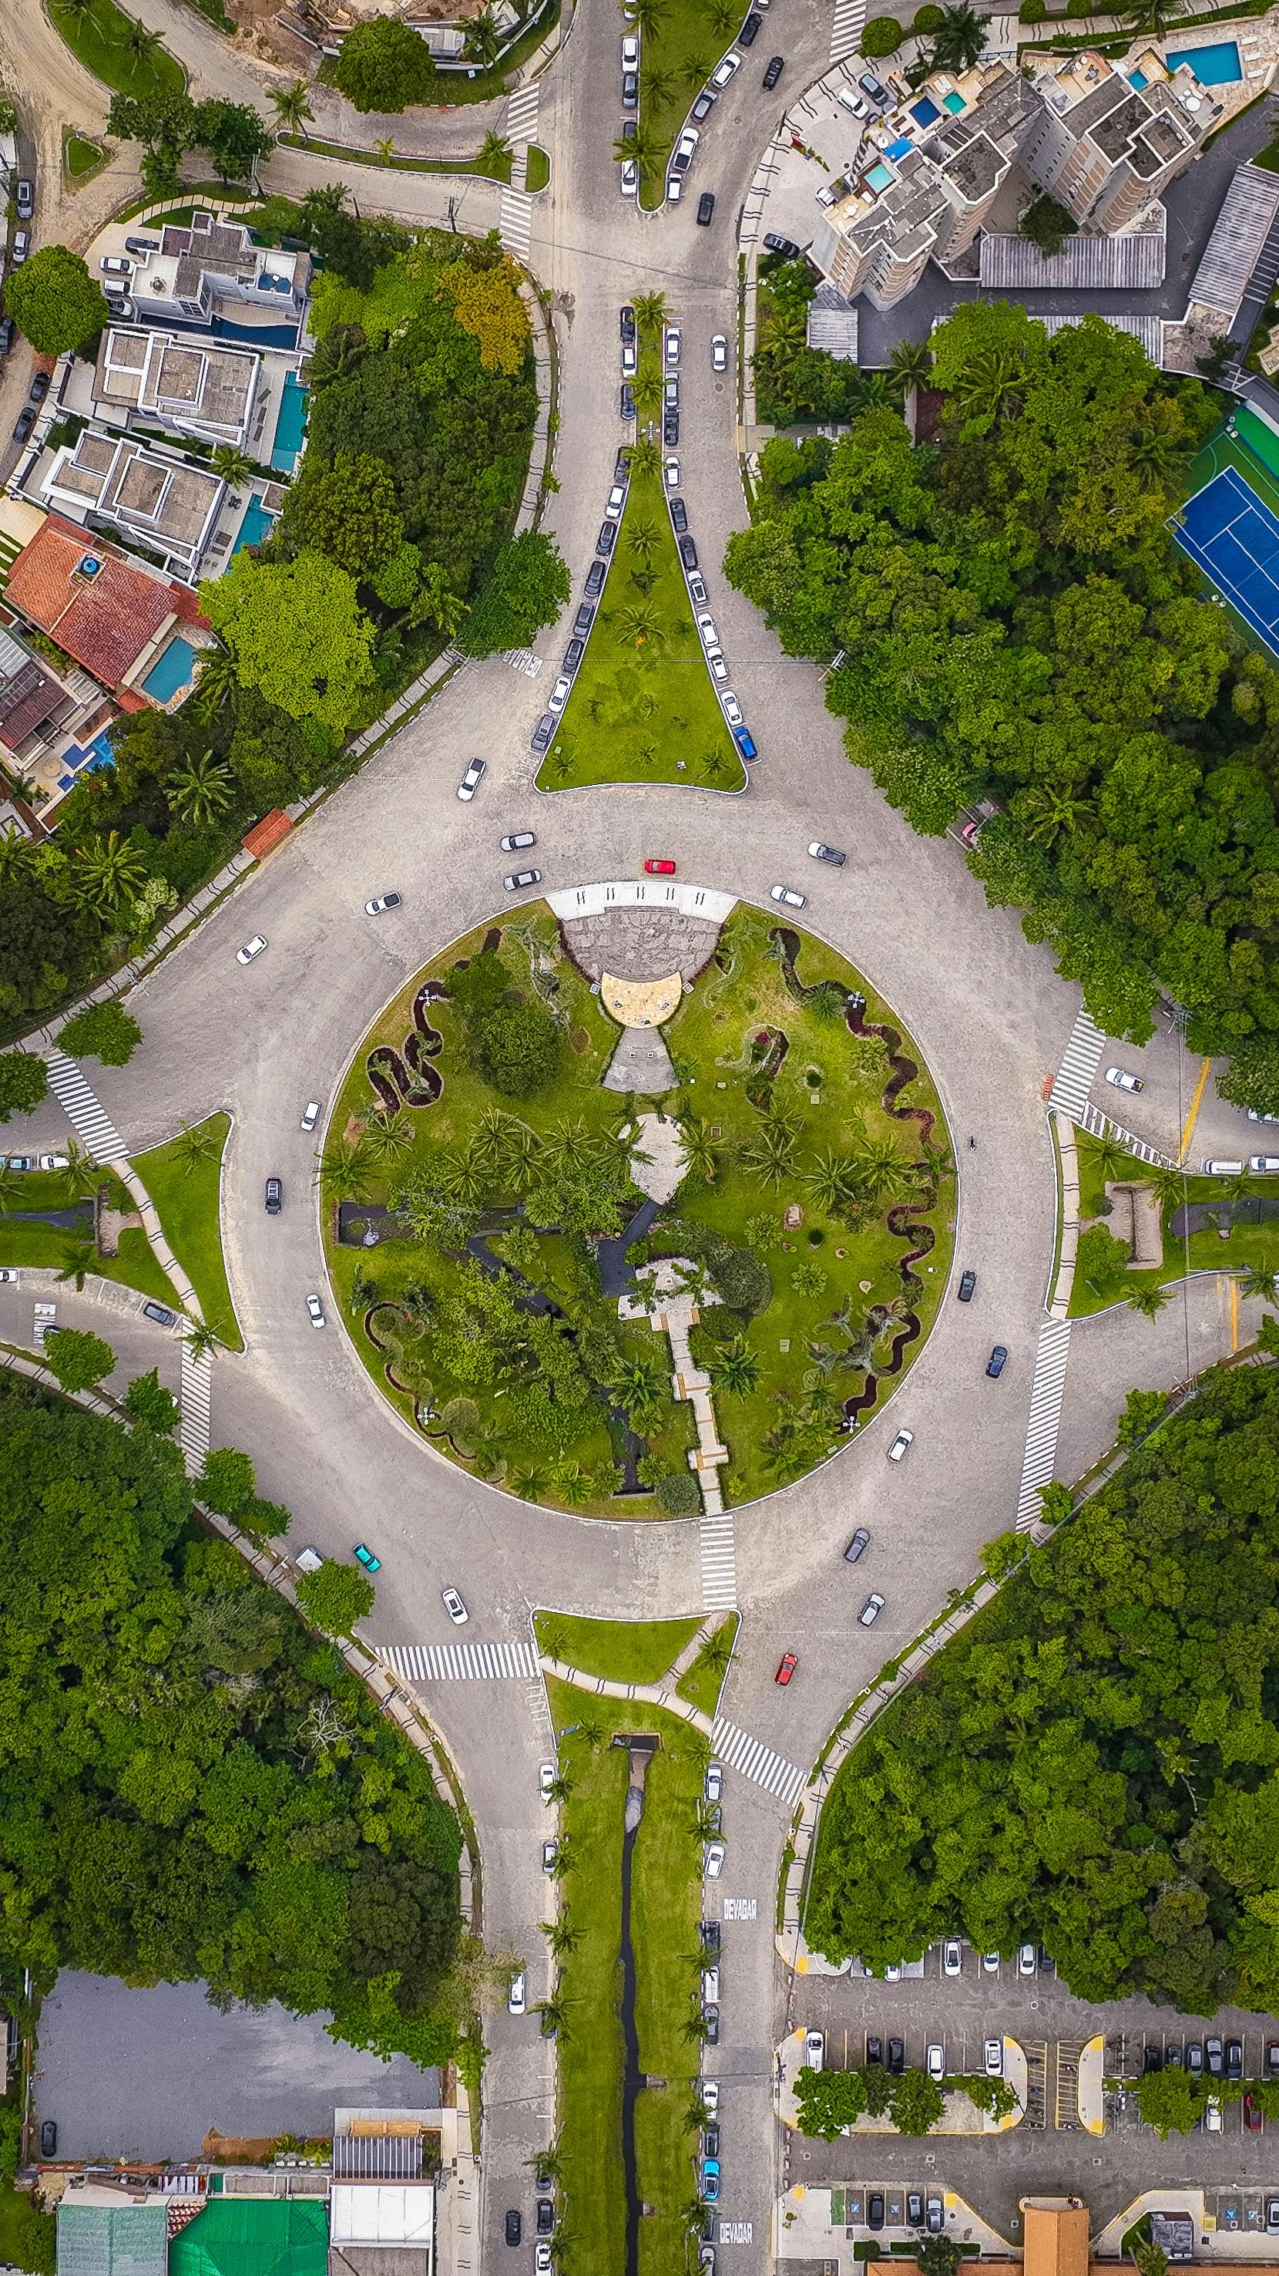
WASTE DETECTION AND CLASSIFICATION FOR SMART RECYCLING
Faculty Of Engineering, University Of Jaffna.
EC 9580: Computer Vision Mini Group Project
Prepared by:
2020E054 – HULANGAMUWA R.R.G.W.B.S.C.
2020E182 – WIJESINGHE L.A.D.P.A.

Slide 2
TABLE OF CONTENT
01
Introduction
09
Model Architectures
02
Problem Statement
10
Training and Validation
03
Objective
11
Evaluation Metrics
12
Model Performance and Results
04
Proposed Solution
05
Dataset Overview
13
Group Contribution
06
Methodology
14
Timeline
07
Dataset Preparation
15
Conclusion
08
Preprocessing Steps

Slide 3
INTRODUCTION
Rapid increase in global waste generation poses significant environmental challenges.
Inefficient recycling systems result in contaminated recyclable materials, reducing their usability.
Manual sorting of waste is:
Time-consuming and labor-intensive.
Prone to human errors.
Risky for workers exposed to hazardous materials.
Growing need for automated solutions to improve waste segregation and recycling efficiency.

Slide 4
PROBLEM STATEMENT
Current recycling systems struggle with accurate and efficient waste segregation.
Manual sorting is time-consuming, prone to errors, and exposes workers to hazardous materials.

Slide 5
OBJECTIVE
To develop an automated waste detection and classification system that enhances recycling efficiency by accurately identifying and categorizing waste into six main types:
Glass, Paper, Cardboard, Plastic, Metal, Biological

Slide 6
PROPOSED SOLUTION
A computer vision-based system leveraging Convolutional Neural Networks (CNNs) trained on the Garbage Dataset to classify waste.
The model aims to achieve an accuracy of at least 85% to ensure high reliability in real-world applications.
Significance:
Promotes sustainable waste management.
Reduces manual labor and human exposure to hazards.
Enhances recycling rates by minimizing contamination.

Slide 7
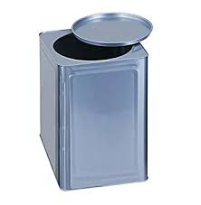
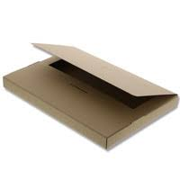
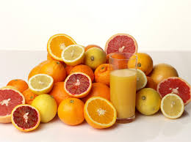
DATASET OVERVIEW
Source: Garbage Dataset from Kaggle.
Description: A collection of waste images categorized into 10 classes:
Metal, Glass, Biological, Paper, Battery, Trash, Cardboard, Shoes, Clothes, Plastic.
Total Images: 19,407 images.
Dataset Link:
https://www.kaggle.com/datasets/sumn2u/garbage-classification-v2

Slide 8
METHODOLOGY
Data Collection and Pre-Processing
Resizing Images: Standardized all images to 100x100 pixels for uniform input size.
Balancing Data: Sampled 400 images per class to address class imbalance, ensuring fair representation.
Modeling
1. Classification:
Architecture: CNN with convolutional, pooling, and dense layers.
Data Augmentation: Applied rotation, flipping, zooming, and shifting to improve generalization.

Slide 9
METHODOLOGY
2. Detection:
Model: YOLO for real-time object detection.
Features: Identified waste with bounding boxes and class predictions using fine-tuned pre-trained weights.
Evaluate the model

Slide 10
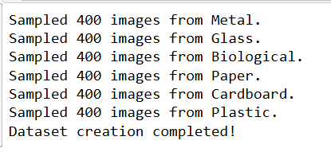
DATASET PREPARATION
Balanced Dataset Creation
Objective: Ensure equal representation of all target categories.
Steps:
Target Categories: Metal, Glass, Biological, Paper, Cardboard, Plastic.
Sampling: Selected 400 images per category to balance the dataset.
Final Dataset Size: 2400 images.

Slide 11
Data Augmentation
Objective: Increase dataset diversity and improve model generalization.
Techniques Used:
Rotation: Random rotation of images up to 40 degrees.
Horizontal Flipping: Randomly flip images horizontally to simulate different orientations.
Zoom: Random zooming of images up to 20% to create varied scales.
Shifts:
Width shift range: 10%.
Height shift range: 10%.
Fill Mode: Pixels outside the boundary of the image are filled using the nearest pixel value.

Slide 12
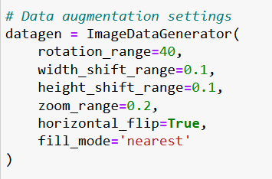
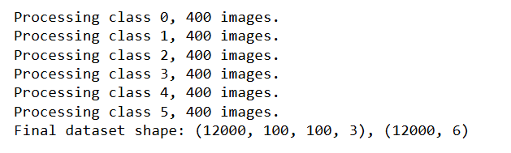
Results:
Dataset size significantly increased with 4 additional augmented images per original image.
Augmented dataset with additional samples to enhance variability.

Slide 13
PREPROCESSING STEPS
1. Image Resizing:
Resized all images to 100×100 pixels using OpenCV.
Ensures uniform input dimensions for the CNN.
2. Data Normalization:
Scaled pixel values to the range [0,1].
Improves model convergence during training.
3. Label Encoding:
Mapped waste categories to numeric labels using a dictionary.
Applied one-hot encoding to convert labels into a categorical format for six classes:
Metal, Glass, Biological, Paper, Cardboard, Plastic.

Slide 14
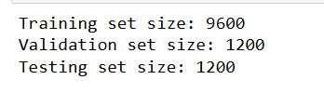
4. Dataset Splitting:
Divided the dataset into training, validation, and testing subsets:
Training Set: 9600 images.
Validation Set: 1200 images.
Testing Set: 1200 images.

Slide 15
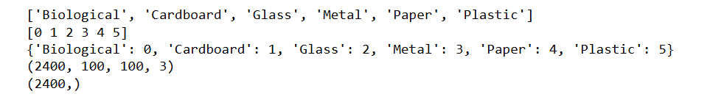
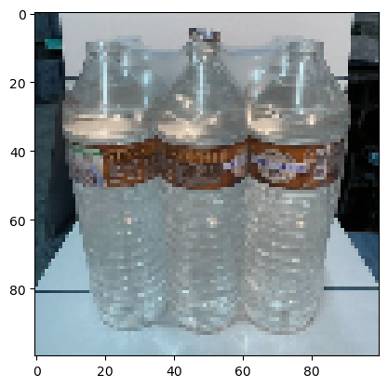

Outputs and Results:
Visualize the image in the data array:
Shape details of the data array:

Slide 16
MODEL ARCHITECTURES
Classification Model With Convolutional Neural Network (CNN)
Input: Images resized to 100 × 100 × 3.
Layers Overview:
1. Three Convolutional Layers:
Filters: 16, 32, and 64.
Kernel sizes: 3 × 3 and 5 × 5.
Activation: ReLU.
Batch Normalization and MaxPooling for stability and downsampling.
2. Fully Connected Layer: 512 units with ReLU activation and 50% dropout.
3. Output Layer: 6 units with sigmoid activation for multi-class classification.

Slide 17
Detection Model With YOLOv5
YOLOv5 Overview:
Lightweight YOLOv5s model for real-time object detection.
Pre-trained on the COCO dataset, achieving efficient detection with bounding boxes and confidence scores.
Integration with Classification Model:
YOLO detects objects and provides bounding boxes with confidence >40%.
Detected regions are cropped, resized to 100 × 100, and normalized.
Cropped regions are classified using the CNN model to assign waste category labels.
Output combines YOLO bounding boxes and CNN labels.

Slide 18
TRAINING AND VALIDATION
Classification Model With Convolutional Neural Network (CNN)
Training Setup:
Optimizer: RMSprop with a learning rate of 0.001.
Loss: Binary cross-entropy.
Batch Size: 16.
Epochs: 50 with callbacks for early stopping and learning rate reduction.
Validation:
20% of data reserved for validation.
Validation loss and accuracy monitored during training.

Slide 19
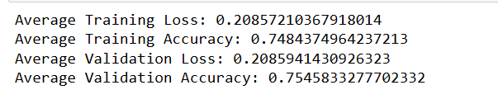
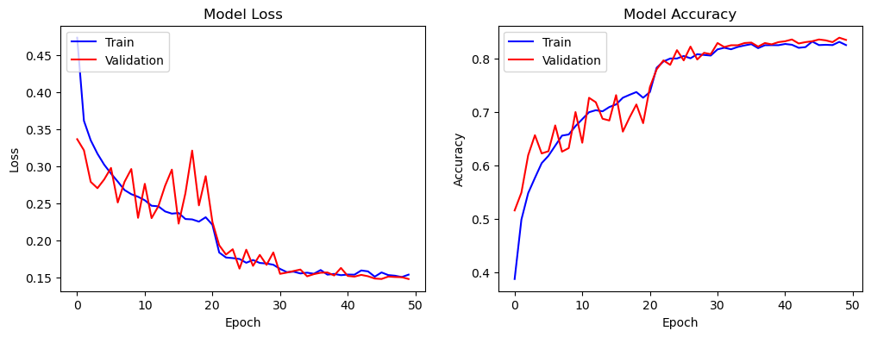
Average Training and Validation Loss and Accuracy:
Training and Validation Loss and Accuracy Trends Across Epochs:

Slide 20
Detection Model With YOLOv5
Pre-trained YOLOv5s Weights:
Used YOLOv5s model pre-trained on the COCO dataset for robust real-time object detection.
No additional training required, ensuring efficient performance.
Integration Process:
1. YOLO detects objects in webcam frames, extracting bounding boxes, confidence scores, and class IDs.
2. Bounding boxes are cropped, resized to, and normalized for CNN compatibility.
3. The custom CNN classifies cropped regions into six waste categories.
4. The final output combines YOLO's bounding boxes with CNN labels, displayed on video frames in real time.

Slide 21
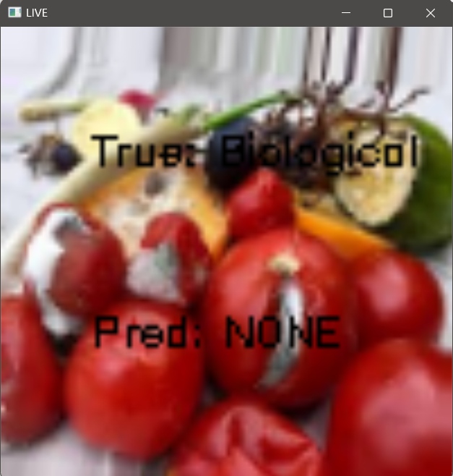
EVALUATION METRICS
Classification Model With Convolutional Neural Network (CNN)
Accuracy: Achieved approximately 86.4% on the test dataset.
Loss: Final test loss approximately 0.15.
Confusion Matrix: Evaluates true positive, false positive, and false negative rates.
Qualitative Results:

Slide 22
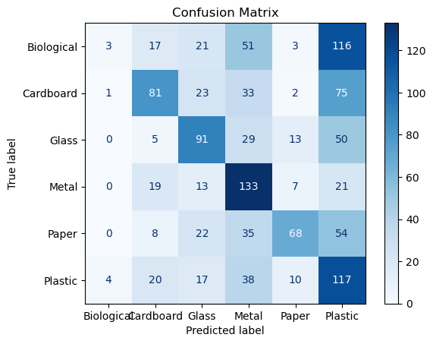
Confusion Matrix:

Slide 23
Detection Model With YOLOv5
YOLO Detection Metrics:
Confidence Threshold: 40%.
Bounding Box Accuracy.
Integrated Metrics:
Real-time detection latency (~30 FPS on the webcam).
Combined accuracy for detection + classification pipeline.

Slide 24
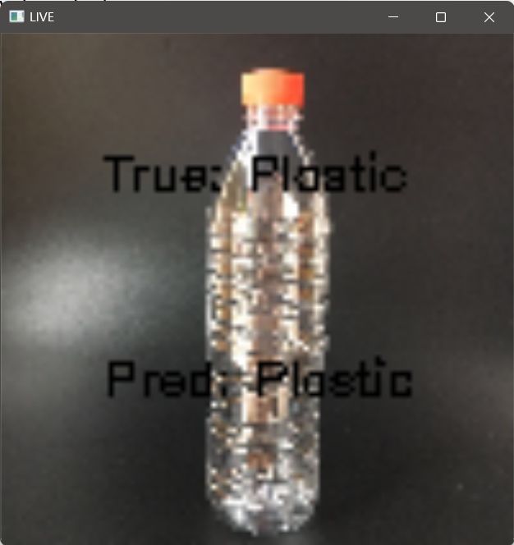
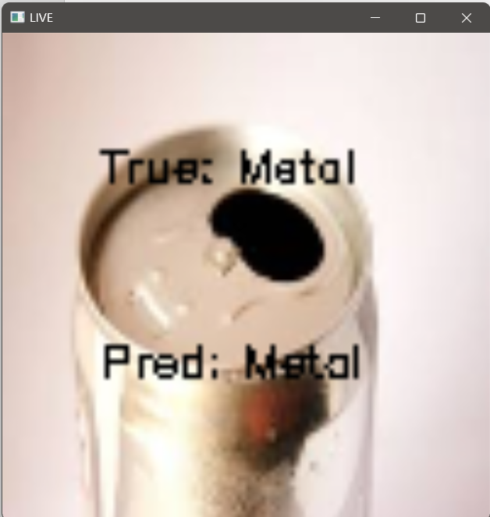
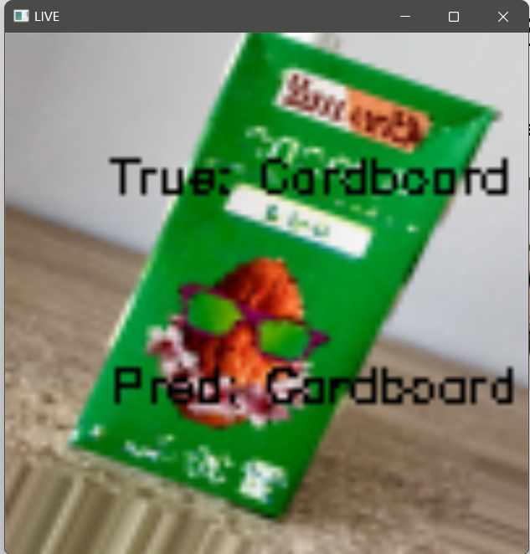
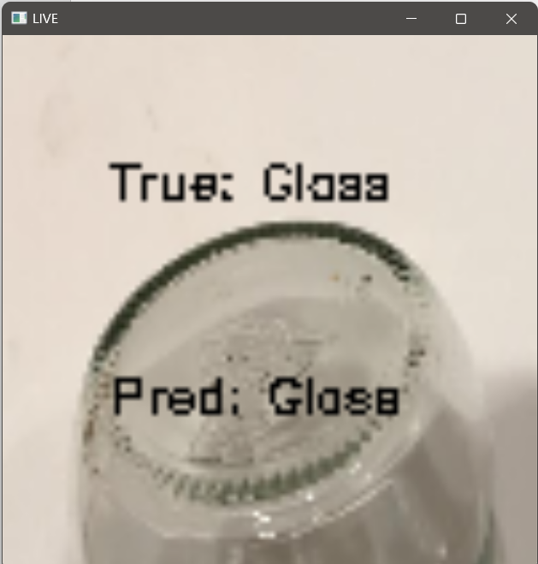
MODEL PERFORMANCE AND RESULTS
Classification Model With Convolutional Neural Network (CNN)
Example predictions:

Slide 25
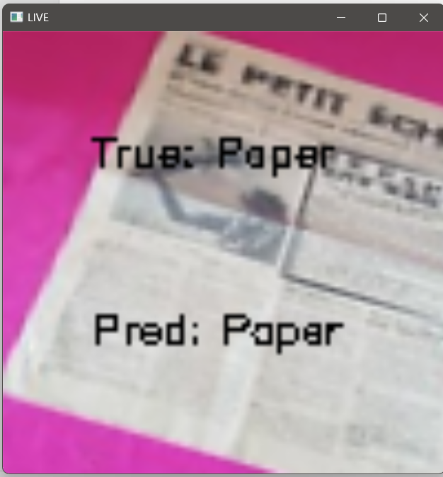
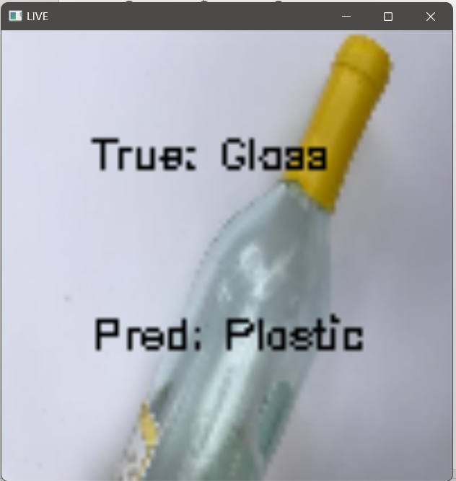
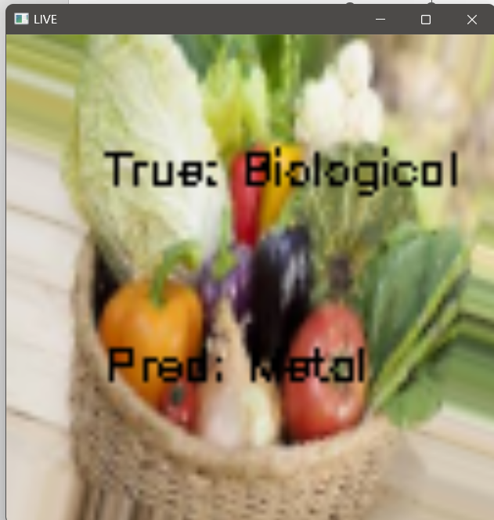
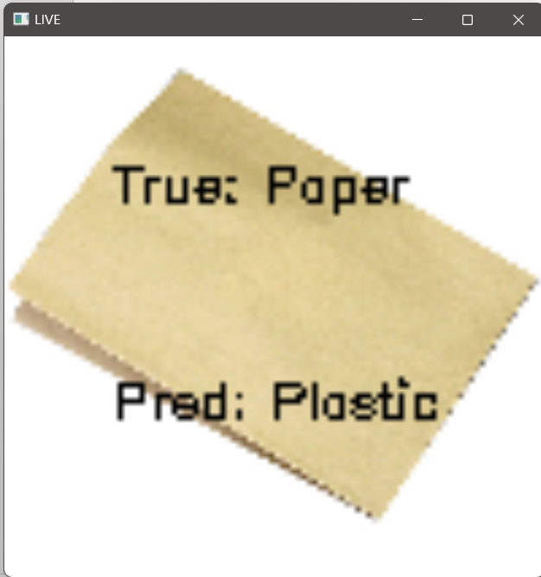
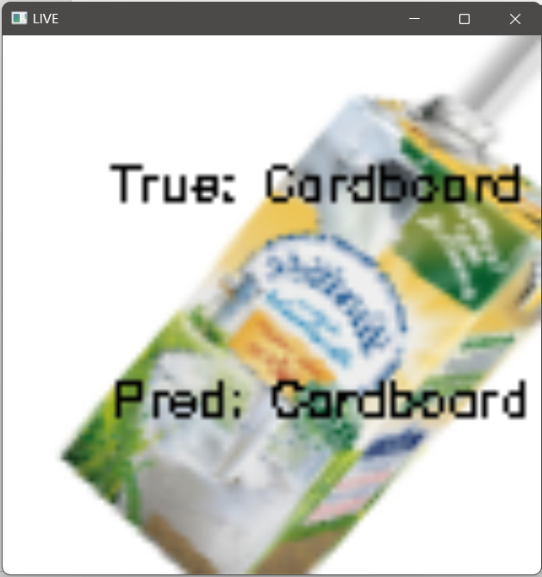
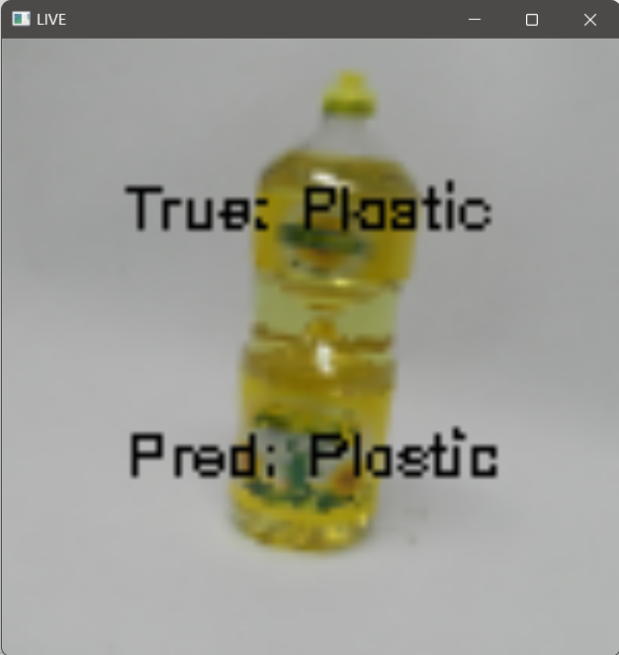
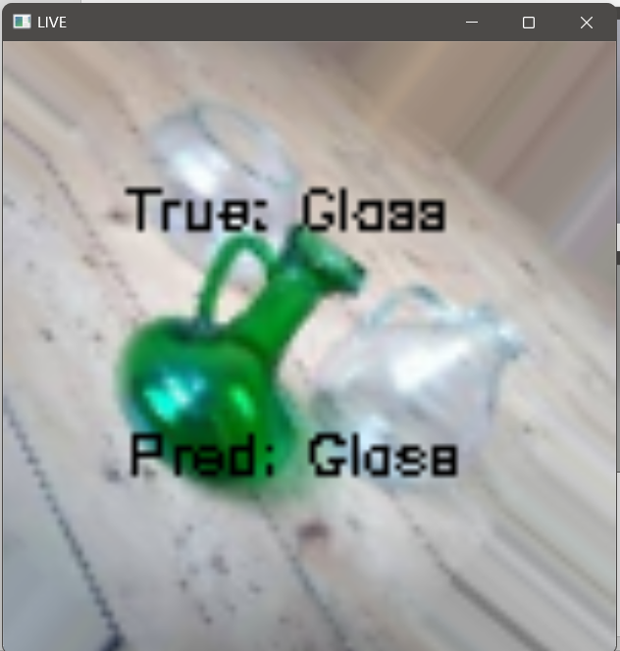
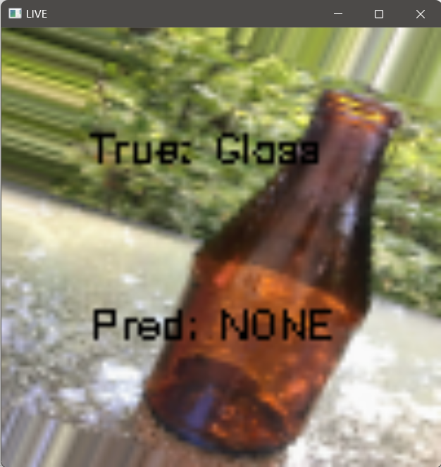

Slide 26
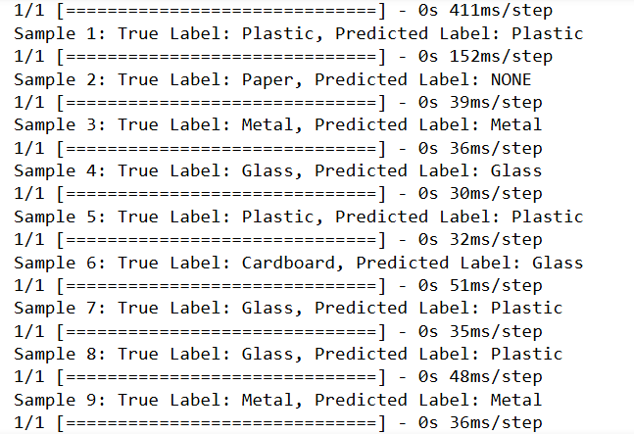
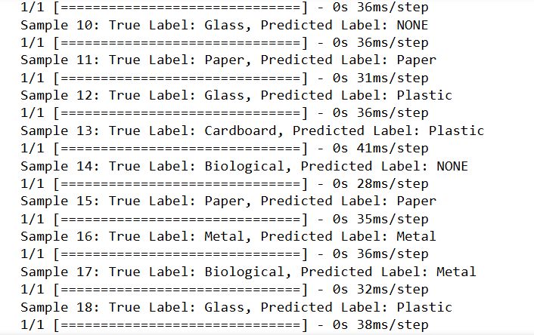
Test accuracy and test loss:

Slide 27
Detection Model With YOLOv5
Screenshots of the detection + classification results from the webcam feed:

Slide 28
GROUP CONTRIBUTIONS
2020/E/054:
Implemented the detection model using YOLOv5.
Integrated YOLOv5 with the custom CNN for classification.
2020/E/182:
Developed and trained the classification model.
Worked on preprocessing steps.
Shared Tasks:
Research, documentation and data collection.
Preparing dataset (balanced sampling and organization).
Creating visualizations.
Final presentation slides preparation and recording.

Slide 29
TIMELINE
 | Weeks
 | 1st | 2nd | 3rd | 4th | 5th | 6th | 7th | 8th | 9th | 10th | 11th | 12th | 13th | 14th
Topic Selection, Research, and Dataset Collection
Dataset Preparation
Classification Model Development
Detection Model Development
Model Testing and Evaluation
Improvements and Optimization
Final Testing
Presentation Preparation

Slide 30
CONCLUSION AND FUTURE WORK
Conclusion
Successfully developed a system for automated waste classification with 86.4% accuracy and object detection for real-world scenarios.
Enhanced recycling efficiency through automation, but challenges remain.
Challenges
Low Accuracy for Biological Waste: Difficulties due to visual similarities with other categories.
Dataset Limitations: Imbalanced data and limited examples for some categories.

Slide 31
CONCLUSION AND FUTURE WORK
Future Work
Expand dataset to include more waste categories.
Improve biological waste classification using advanced techniques.
Enhance detection accuracy and test in real-world environments.

Slide 32
THANK YOU !

